Slide 1
Computer Fundamentals
Dr. Safdar Nawaz Khan Marwat
DCSE, UET Peshawar
Lecture 10

Slide 2
Outline
Modern CPUs

Slide 3
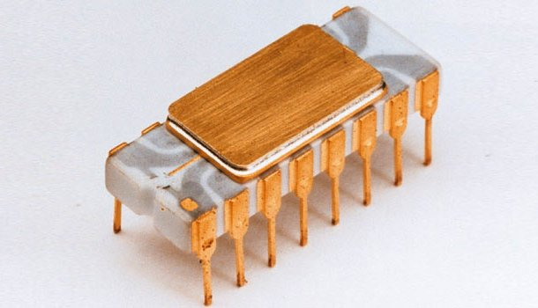
Intel 4004
The 1st commercially available microprocessor
Introduced in 1971
4-bit CPU
2250 transistors
740 kHz max clock rate
Packaged in 16-pin ceramic package
As powerful as ENIAC
Which had 18000 vacuum tubes and occupied a large room
Targeted use: Calculators
Cost: less than $100
Source: https://www.linkedin.com/pulse/intel-4004-italian-job-edoardo-piccari

Slide 4
Intel 4004 (cont.)
Busicom, Japanese calculator manufacturer
Demanded from Intel to develop 16 separate IC’s
For a line of new calculators
Chief designers
Federico Faggin
Ted Hoff
Masatoshi Shima
Intel known only as memory manufacturer at that time
Was quite small
Lacked resources to do all 16 chips
Ted Hoff came up with the idea
Do all 16 on a single chip
Later realized that 4004 could have other uses

Slide 5
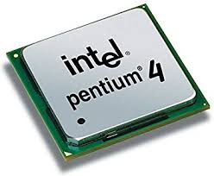
Intel Pentium IV
Introduced in December 2001
Single core CPU
55 million transistors
32-bit processor
2 ALU’s
3.8 GHz max clock rate
For PC’s and low-end workstations
Introductory cost: around $600
Source: https://www.amazon.com/Intel-Pentium-2-6Ghz-SL6PP-Socket/dp/B004NKB7GE

Slide 6
Moore’s Law
Gordon Moore, one of the founders of Intel
Predicted that
The number of transistors on an IC OR the capability of microprocessors
Will double every year
Later modified it to 18 months
Still holds true
In fact, time required for doubling is contracting
Closer to a year now

Slide 7
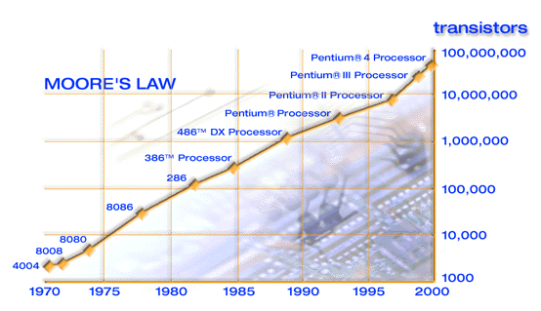
Moore’s Law (cont.)

Slide 8
Koomey’s Law
https://www.extremetech.com/computing/95913-koomeys-law-replacing-moores-focus-on-power-with-efficiency

Slide 9
Metcalfe’s Law
https://en.wikipedia.org/wiki/Metcalfe%27s_law

Slide 10
Big O Notation

Slide 11
Word Length
4004 dealt with data in chunks (words) of 4-bits at a time
Pentium IV deals with data in chunks of 32-bit length
New processors deal with 64-bit chunks at a time

Slide 12
Clock Frequency
4004 worked at a clock frequency of 740 kHz
Pentium IV worked at 3.8 GHz
Latest processors have clock frequencies in GHz
Higher clock frequency results in more power
If both processors have same design
Example: PowerPC & Pentium 4 microprocessors at same frequency
Former performs better due to superior design

Slide 13
Enhancing Performance
Computing capability of microprocessor
Can be enhanced in different ways
By increasing clock frequency
By having a more effective caching algorithm and the right cache size
By adding more functional units (e.g. ALU’s, FPU’s etc.)
Improving architecture (registers, bus etc.)

Slide 14
Looking Inside the Processor
Architecture
Determines
Location of CPU parts
Word size
Number of registers
Pipelines
Main difference between CPUs
Notes:
Teaching tip
Bit size tends to confuse students. A simple example clarifies the importance of bit size. Consider two equal computers, one has a 32-bit processor, the other a 64 bit processor. With all other items equal, the 64-bit processor will handle twice the data the 32 bit processor handles. This is like driving a car at 55 Mph then doubling it to 110 Mph.

Slide 15
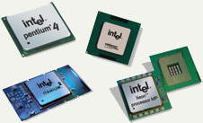
Microcomputer Processors
Intel
Leading manufacturer of processors
Intel 4004 was worlds first commercial microprocessor
IBM PC in 80s powered by Intel 8088
Well known Intel processors
Centrino
Itanium
Pentium IV
Xeon
Core i7

Slide 16

Microcomputer Processors (cont.)
Advanced Micro Devices (AMD)
Main competitor to Intel
Originally produced budget products
Current products outperform Intel
Designed processors
Sempron
Athlon FX 64
Athlon XP

Slide 17
Microcomputer Processors (cont.)
Freescale
A subsidiary of Motorola
Apple computers primarily have Freescale
Currently focuses on Linux market
IBM
Historically manufactured mainframes
Series of high performance microprocessor called POWER
Performance Optimization With Enhanced RISC (POWER)
Named as POWER1, POWER2, up to recent POWER9
Notes:
IBM also manufactures for Apple

Slide 18
Comparing Processors
Frequency of processor
Size of cache
Word size
Speed of system bus

Slide 19
Advanced Processor Topics
RISC processors
Reduced Instruction Set Computing
Smaller instruction sets
May process data faster
Processor capable of executing those instructions using fewer cycles
IBM Power, iPhone, iPad and several Android based-systems
Parallel Processing
Multiple processors in a system
Computational task is broken down in several subtasks
Processed independently
Symmetric Multiple Processing (SMP)
Processors share common memory
Number of processors preferably a power of 2 (divide and crush)
Massively Parallel Processing
Thousands of processors
Mainframes and super computers
Notes:
opposing architecture is called complex instruction set computing (CISC)

Slide 20
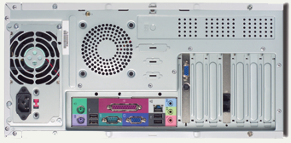
Extending Processors Power
Standard computer ports
Keyboard and mouse ports
USB ports
Parallel
Network
Modem
Audio
Serial
Video

Slide 21
Extending Processors Power (cont.)
Serial and parallel ports
Connect to printers or modems
Parallel ports move bits simultaneously
Made of 8 – 32 wires
Internal busses are parallel
Serial ports move one bit
Lower data flow than parallel
Requires wires for control and ground purposes
Universal Asynchronous Receiver/Transmitter (UART)
Converts from parallel to serial and vice versa
Why USB based on serial architecture?
Assignment 1.

Slide 22
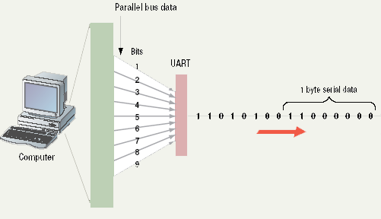
Serial Communications
Notes:
UART: Universal Asynchronous Receiver/Transmitter

Slide 23
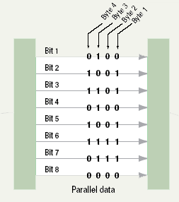
Parallel Communications

Slide 24
Extending Processors Power (cont.)
SCSI
Small Computer System Interface
Set of standards
Physical connection between computers and peripheral devices
For transferring data
Supports dozens of devices
External devices daisy chain
Fast hard drives and CD-ROMs
USB
Universal Serial Bus
Most popular external bus
Supports up to 127 devices
Hot swappable
FireWire
IEEE 1394
Cameras and video equipment
Hot swappable
Port is very expensive

Slide 25
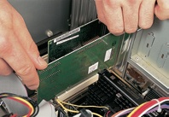
Specialized Expansion Ports
Expansion slots and boards
Allows users to configure machine
Slots allow addition of new devices
Devices are stored on cards
Computer must be off before inserting
PC Cards
Expansion bus for laptops
Standardized by PCMCIA
Personal Computer Memory Card International Association
Hot swappable
Small card size
Three types
I for memory
II for network adapters
III for hard drives
Plug and play
New hardware detected automatically
Prompts to install drivers
Non-technical users can install devices
Notes:
Insider Information
Plug and play was introduced by Apple Computers.

Slide 26
Microcontrollers
A type of microprocessor systems
Not very powerful, not expensive
Found embedded in
Video games
VCRs
Microwave ovens
Printers
Autos, etc.
Complete CPU on a chip
Direct input/output capability and memory
Specialized application-specific components
More than 90% of the microprocessors are microcontrollers
Manufactured for embedded computing applications
In 2000, 365 million microprocessors and 6.4 billion microcontrollers manufactured

